Slide 1
Welcome To My Presentation

Slide 2
PresentationTopic :Introduction of TV
Submitted To
Md Imran Hossain
Assistant professor
Department of ICT
Comilla university
Submitted By
Md Absar
ID:11809023
Dept. Of ICT
Comilla university

Slide 3
Outline of Topics
# What is TV And Its Uses?
# History of TV
#what is importances of TV?
# Type of TV
# Analoge TV and Digital TV
#Benefits of TV
#Disadvantages of TV

Slide 4
What is TV and its uses?
Television is a system for transmitting visual images and sound that are reproduced on screens, chiefly used to broadcast programs for entertainment, information, and education. The television set has become a commonplace in many households, businesses, and institutions.

Slide 5
History of TV
Philo Taylor Farnsworth
Electronic television was first successfully demonstrated in San Francisco on Sept. 7, 1927. The system was designed by Philo Taylor Farnsworth, a 21-year-old inventor who had lived in a house without electricity until he was 14.

Slide 6
What is the importance of television?
It broadens knowledge of different cultures, promotes tolerance and global understanding of international issues. Through current affairs, discovery, lifestyle, cooking shows and children's programmes, television encourages scientific and cultural curiosity.

Slide 7
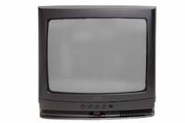
What are the types of television?
A. Types of Televisions by Technology
Quantum Light-Emitting Diode. Just a few years old, quantum light-emitting diode (QLED) displays are the next generation of LCD displays. ...
Organic Light-Emitting Diode (OLED) Display. ...
LED TVs. ...
Liquid Crystal Display (LCD) ...
Digital Light Processing (DLP) ...
Plasma Panels. ...
Direct TV.

Slide 8
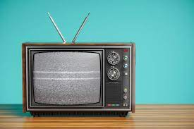
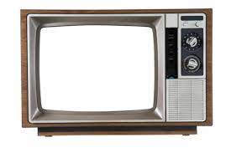
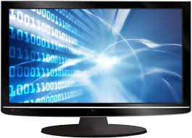
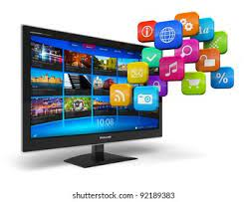
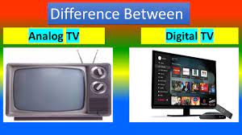

Slide 9
The Benefits of Watching TV
Educational. TV has many educational benefits for children and adults. ...
Stay Current. TV is a source of news. ...
Get Cultured. TV can provide a cheap escape instead of travelling. ...
Crazy Fandoms are Fun. ...
Feel the Connection. ...
Family Bonding. ...
Learn a Language. ...
Mental Health.

Slide 10
e Disadvantages of Television
Overstimulated Brains. ...
Television Can Make Us Antisocial. ...
Televisions Can be Expensive. ...
Shows can be Full of Violence and Graphic Images. ...
TV Can Make You Feel Inadequate. ...
Adverts Can Manipulate Us Into Spending Money. ...
TV Can Waste Our Time.

Slide 11
Thanks Everyone

